Slide 1


SMART INDIA HACKATHON 2024
Problem Statement ID – 1571
Problem Statement Title- Drone-based Intelligent ET sensing system and irrigation water use accounting system for irrigation commands
Theme- Robotics and Drones
PS Category- Hardware
Team Name - Agro-Aero

Slide 2
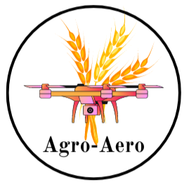
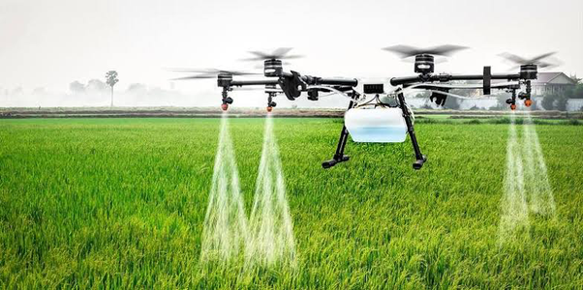
DRONE IRRIGATION SYSTEM
Prospectives :
(DRONE BASED SPRINKLER IRRIGATION)
A drone-based water sprinkler.
A drone based sprinkler for spraying pesticides, insecticides and herbicides.
A drone based water sprinkler for sports ground irrigation.
A drone based sprinkler for irrigation in Plant nurseries and difficult terrains.
Fig 1: Drone based water Irrigation
system

Slide 3
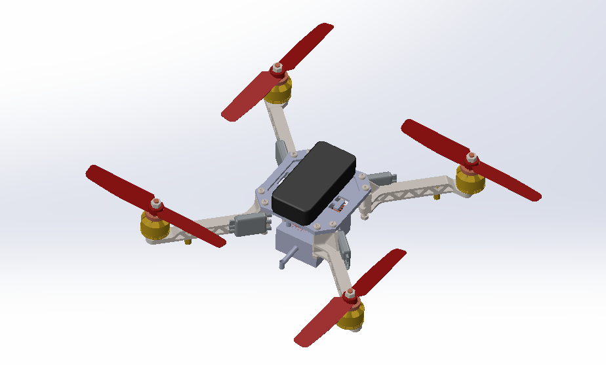
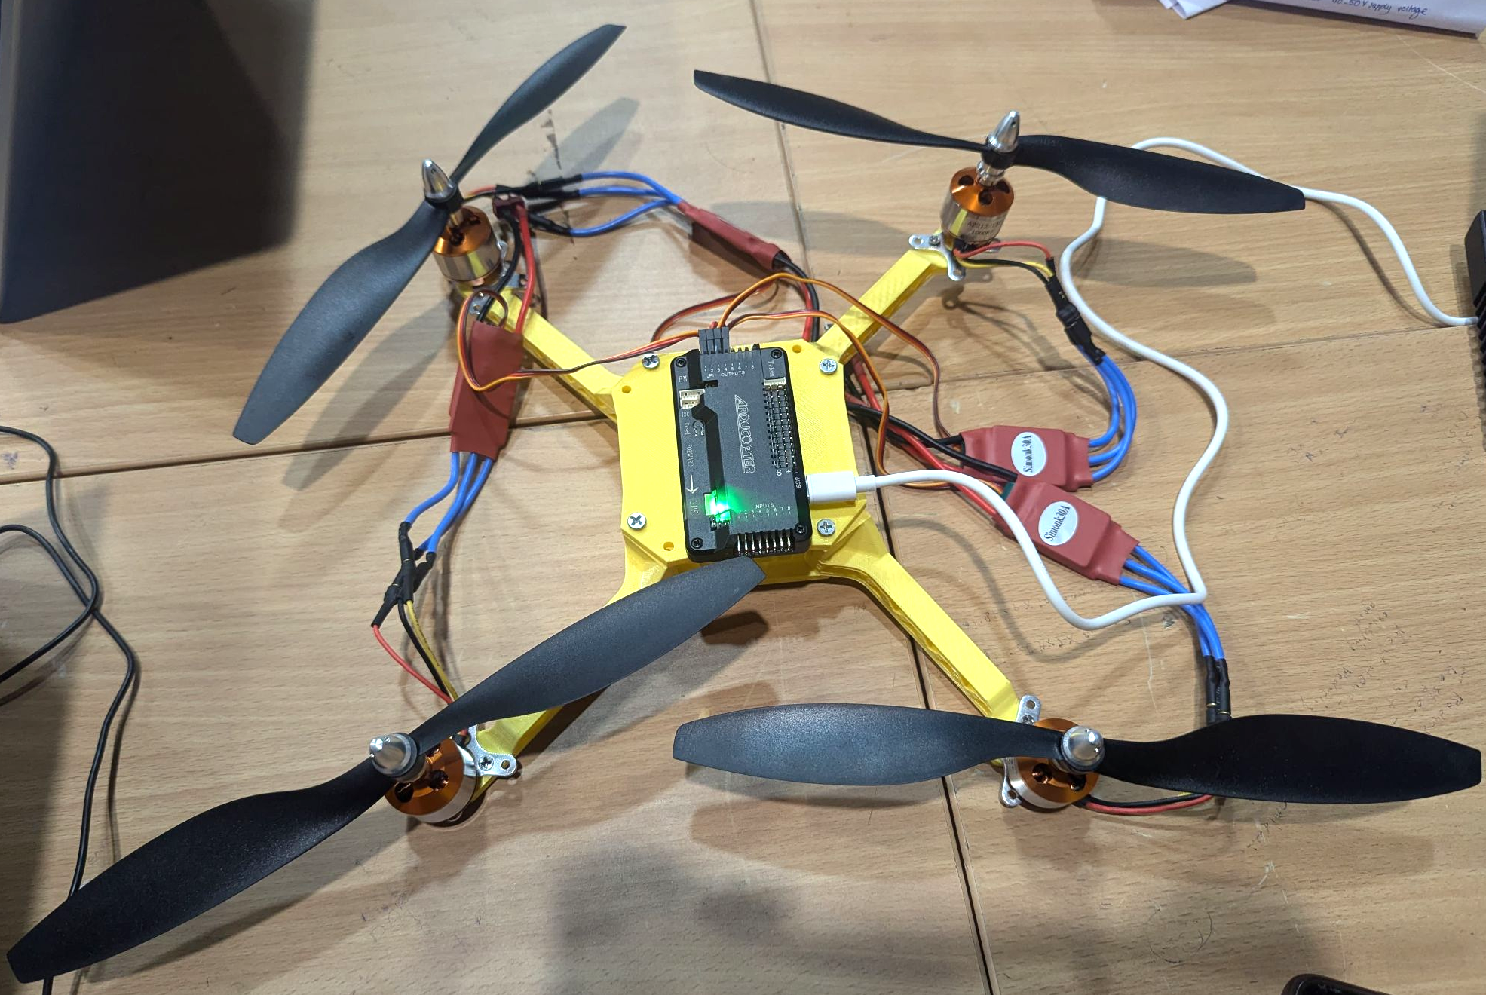
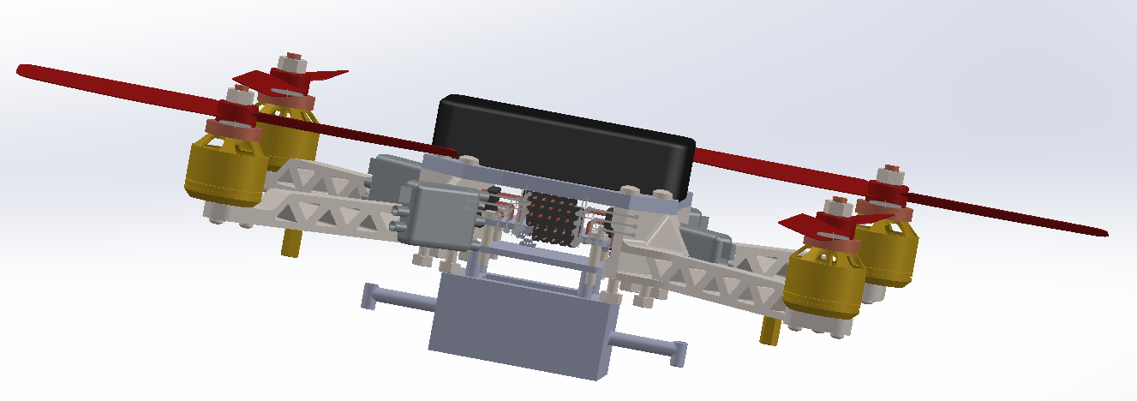
TECHNICAL APPROACH
Designing the following components using 3D printing:-
Drone equipped with Water Transpiration system
Tank designing for water storage
Nozzle Designing for spraying water and pesticides.
Fig 4: Isometric view of
SolidWorks model
Fig 2 : Working Model of Design
Fig 3 : Side View of SolidWorks Model

Slide 4
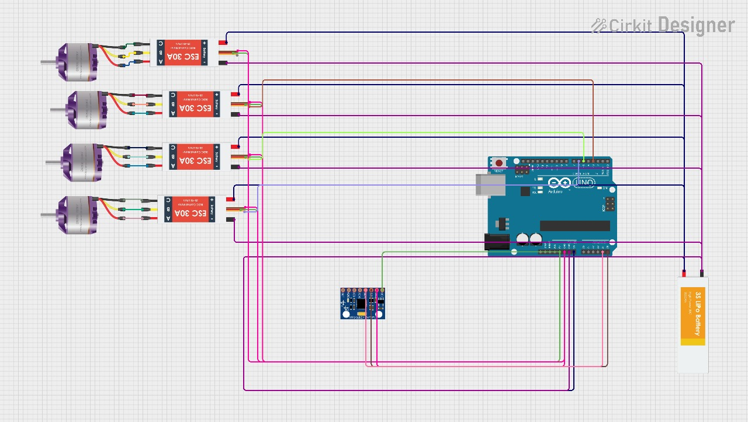
TECHNICAL APPROACH
CIRCUIT DESIGN
The system features a GPS-based positioning system, meticulously designed and integrated with an Arduino UNO R3 board.
The Arduino board sends signals to the Electronic Speed Controller (ESC), enabling the drone to:
Pinpoint its location with precision
This accurate positioning facilitates:
Targets mapping
Spraying
Ensuring efficient and effective aerial operations.
Fig 5 : Circuit Diagram for Quadcopter Model

Slide 5
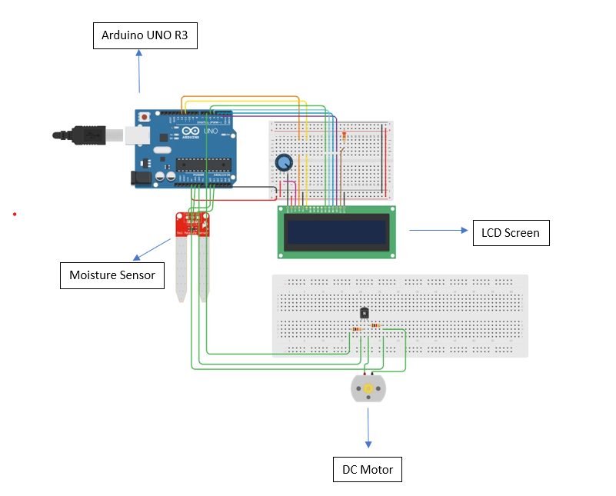
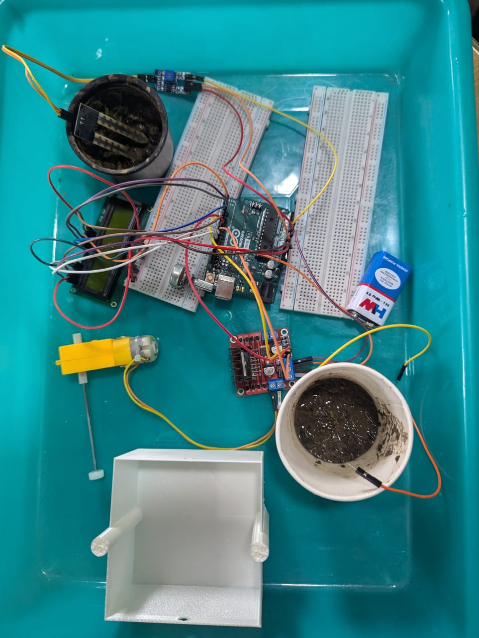
TECHNICAL APPROACH
CIRCUIT DIAGRAM
The system utilizes a Soil Moisture Sensor to:
Accurately measure the moisture content present in the soil.
Display the reading on an LCD screen
This data enables the classification of the soil as either:
Dry
Humid
Based on this information, the pump is triggered to optimized speed according to moisture data already feed in system :
Pump water through the water delivery system attached to the drone.
Ensure optimal irrigation via the sprinkler system.
Fig 6 : Circuit Model of Soil Moisture Sensor
Fig 7 : Real Circuit Model of Soil Moisture Sensor

Slide 6
FEASIBILITY AND VIABILITY
Technical Feasibility: The use of drones for sprinkling pesticides and irrigation is technically feasible. Drones equipped with GPS, sensors, and spraying systems can navigate and target specific areas with high accuracy.
Social Viability: The use of drones for sprinkling pesticides and irrigation can improve crop yields, reduce the risk of chemical exposure for farmers, and promote sustainable agriculture, making it a socially viable option.
Market Viability: The demand for precision agriculture and sustainable farming practices is increasing, creating a growing market for drone-based sprinkler systems.
IMPACT AND BENEFITS
Reduced Operational Expenses:Drones equipped with thermal or multispectral cameras can detect areas of the field that require more water, allowing farmers to optimize irrigation and reduce water waste.
Data-Driven Decision Making:Drones can provide valuable insights into crop health, soil moisture, and weather patterns, enabling farmers to make data-driven decisions about irrigation and other farm operations.
Targeted Crop Care: Targeted crop care through drone irrigation can also lead to reduced chemical usage, as farmers can apply treatments only where they are needed, rather than blanket-applying them across the entire field.
Enhanced Accessibility: Drone irrigation can enhance accessibility in difficult terrain.

